Slide 1
HEART DISEASE PREDICTION
Nguyen Thi Thuy
Python20

Slide 2
CONTENT
Problem definition
Load and analyse dataset
Validation Set
Evaluate algorithms
Finalize the model
Validate model results

Slide 3
PROBLEM DEFINITION
Input: Potential risk factor. There are both demographic, behavioural and medical risk factors.
Output: Heart disease or not

Slide 4
DATASET
There are 13 attributes
age: age in years
sex: sex (1 = male; 0 = female)
cp: chest pain type: Value 0: typical angina, Value 1: atypical angina, Value 2: non-anginal pain, Value 3: asymptomatic
trestbps: resting blood pressure (in mm Hg on admission to the hospital)
chol: serum cholestoral in mg/dl
fbs: (fasting blood sugar > 120 mg/dl) (1 = true; 0 = false)
restecg: resting electrocardiographic results: Value 0: normal, Value 1: having ST-T wave abnormality (T wave inversions and/or ST elevation or depression of > 0.05 mV), Value 2: showing probable or definite left ventricular hypertrophy by Estes' criteria
thalach: maximum heart rate achieved
exang: exercise induced angina (1 = yes; 0 = no)
oldpeak = ST depression induced by exercise relative to rest
slope: the slope of the peak exercise ST segment: Value 0: upsloping, Value 1: flat, Value 2: downsloping
ca: number of major vessels (0-3) colored by flourosopy
thal: 0 = normal; 1 = fixed defect; 2 = reversable defect and the label
OUTPUT: condition: 0 = no disease, 1 = disease

Slide 5
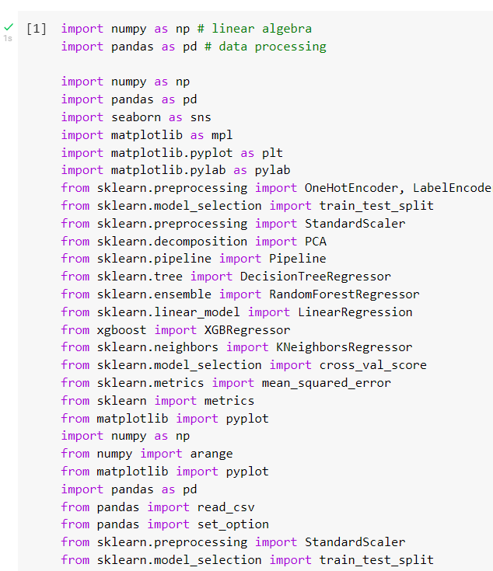
Import library

Slide 6
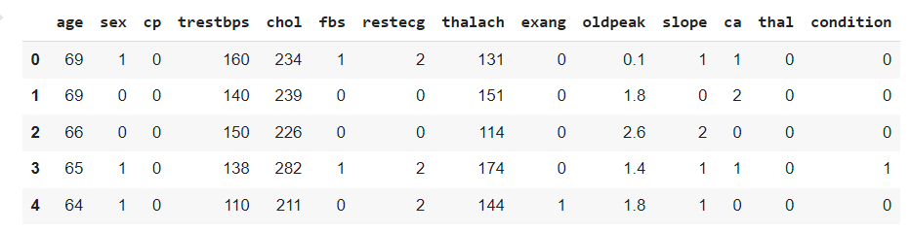
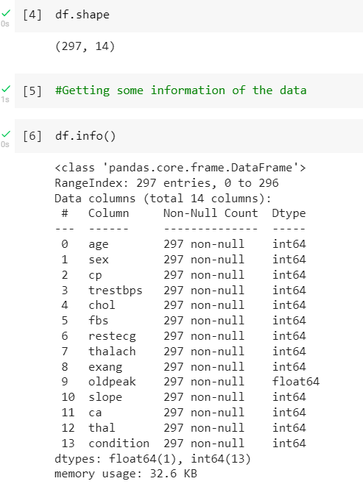
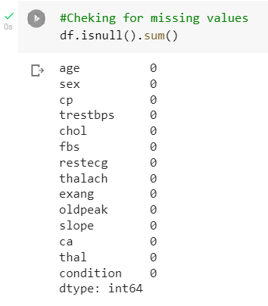
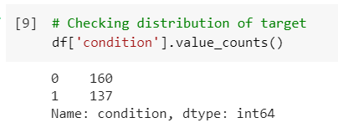
DATASET

Slide 7
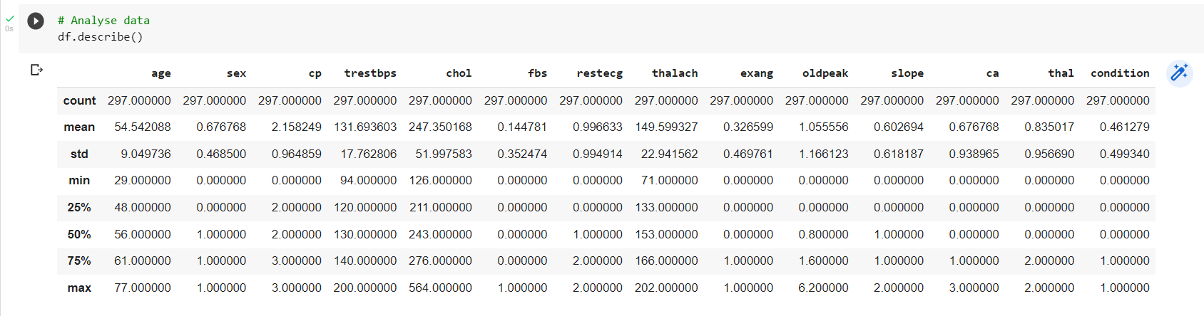
ANALYSE DATASET

Slide 8
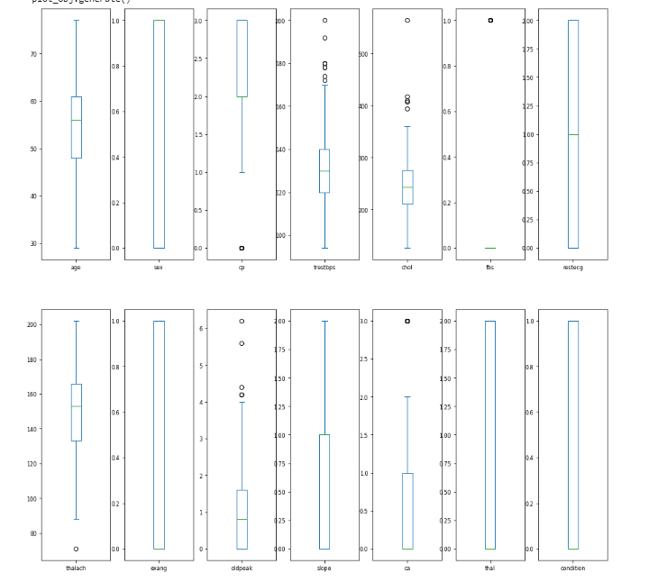
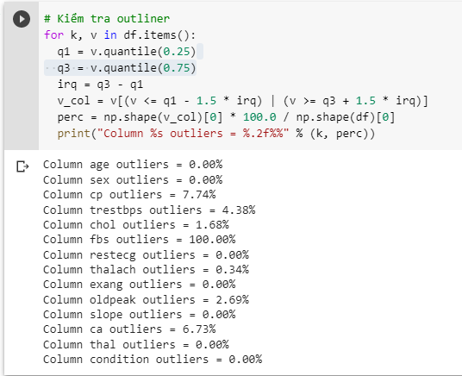
ANALYSE DATASET

Slide 9
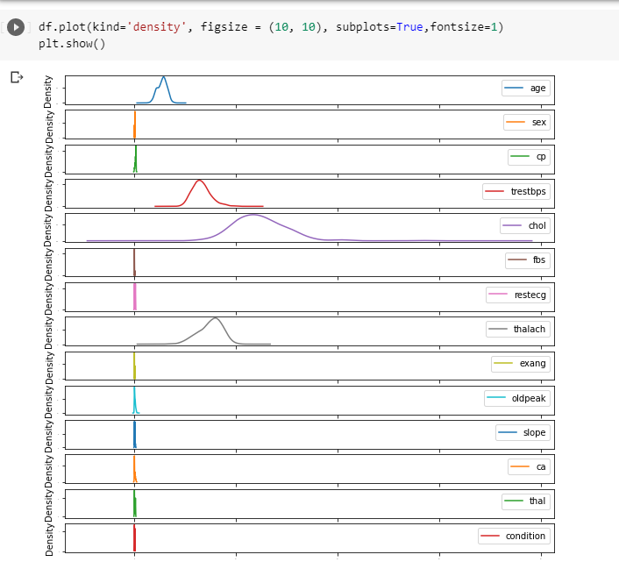
ANALYSE DATASET

Slide 10
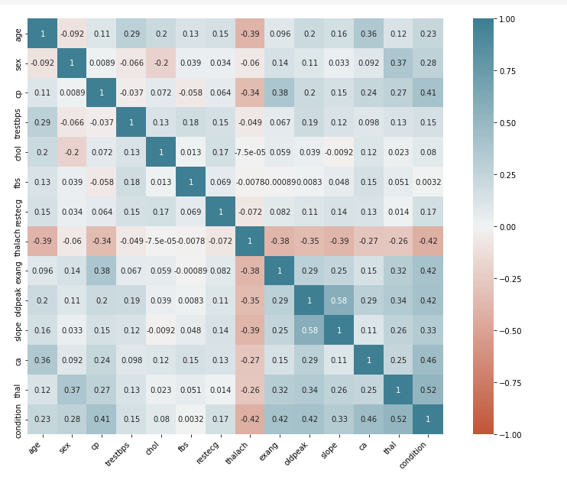
ANALYSE DATASET

Slide 11
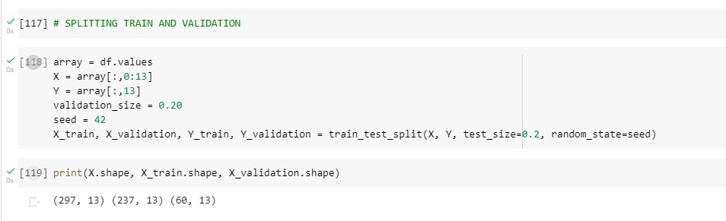
VALIDATION SET

Slide 12
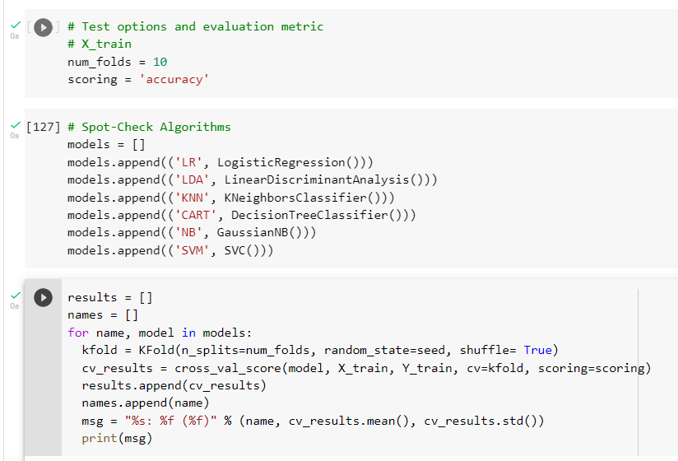
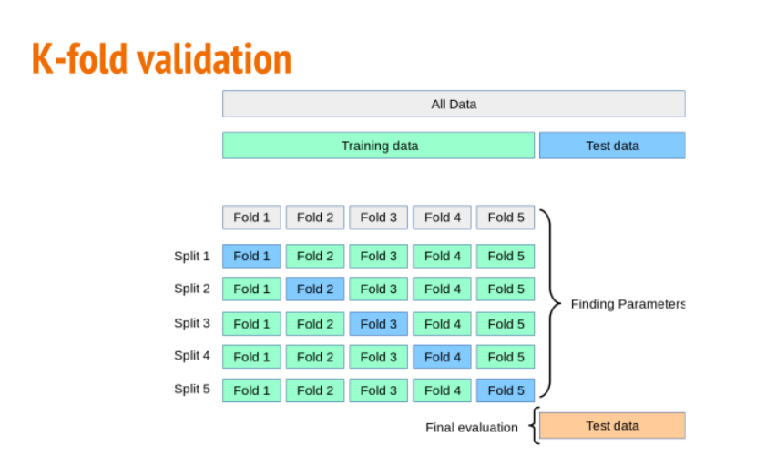
VALIDATION SET

Slide 13
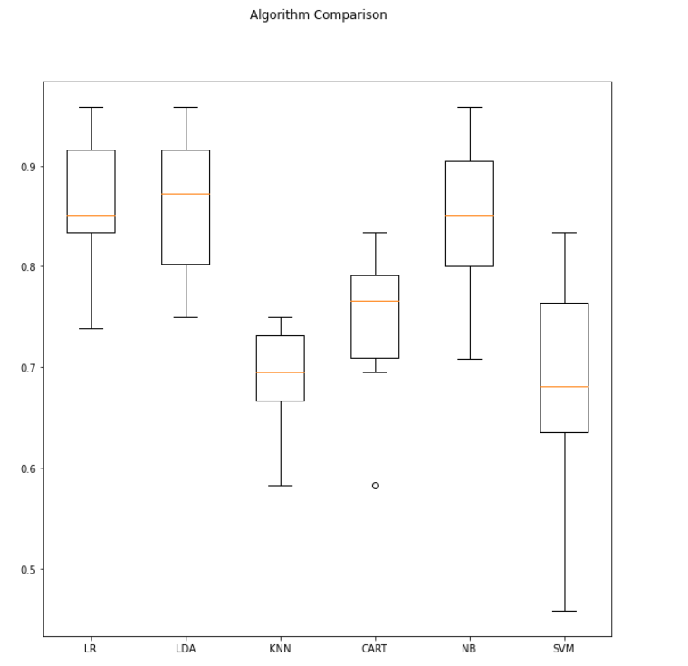
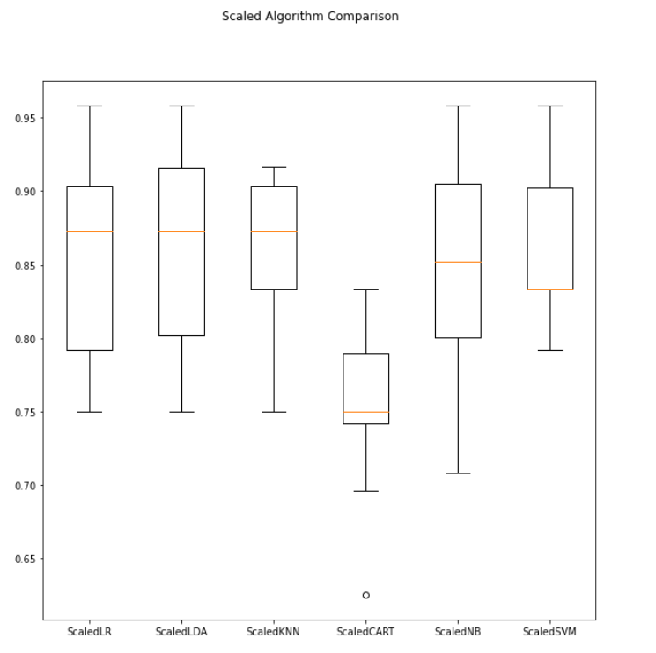
VALIDATION SET
LR has the highest score

Slide 14
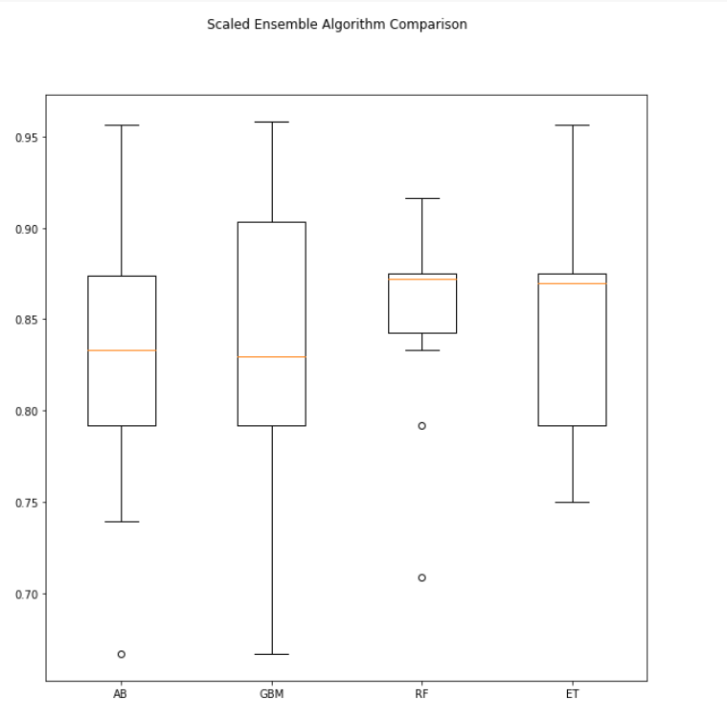
ENSEMBLE ALGORITHM

Slide 15
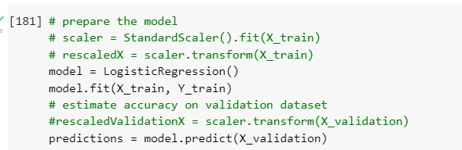
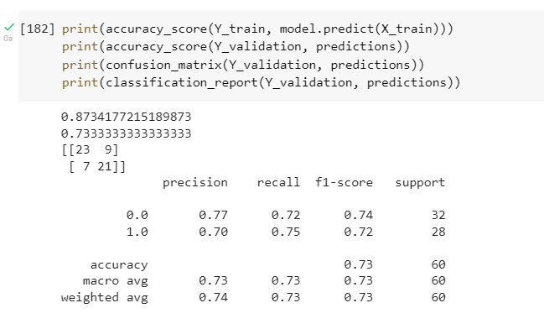
FIT DATA BY USING LR AND FIND ACCURACY

Slide 16
THANK YOU ^^

